Slide 1
Program C Well Site Selection
Process
Technical discussion today, identifying selection factors and hydrogeology
No final site is selected or recommended at this time
Environmental review with multiple alternatives
Staff recommends final site
Final property purchase after environmental review
Coast Development Permit process

Slide 2
Program C Well Site Selection
No assumptions on willingness of sellers
Other sites may be identified and pursued
Other factors or criteria may be identified

Slide 3
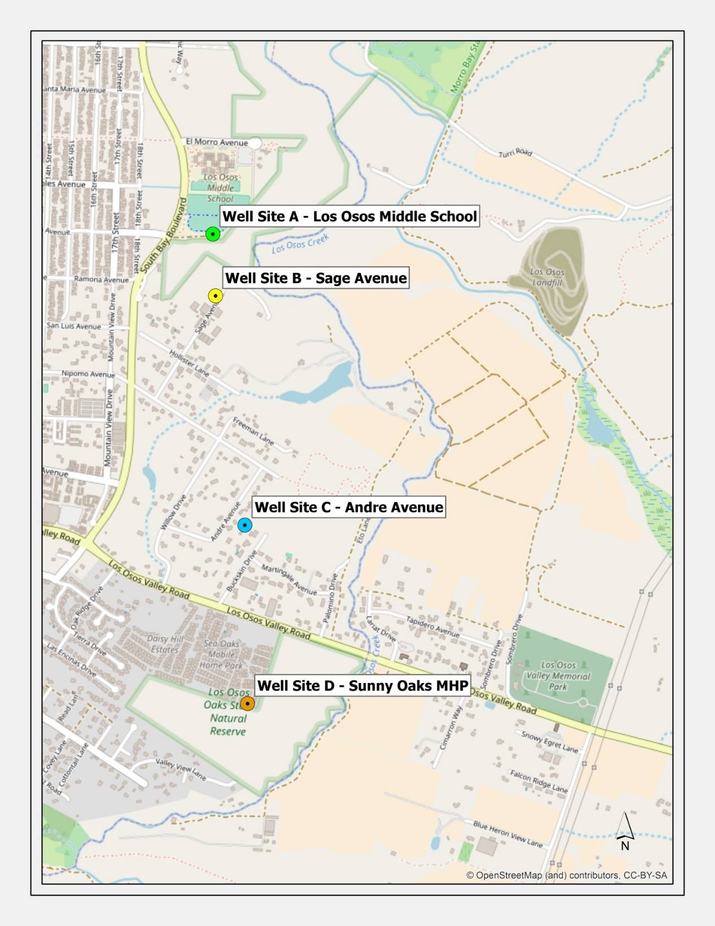
Site A – Adjacent to LOMS Play Fields
South Bay Blvd
Site B – Private Property on Sage Avenue
Site C – Private Property on Andre Avenue
Los Osos Valley Road
Site D – Vacant Area South of Sunny Oaks MHP
Los Osos Creek

Slide 4
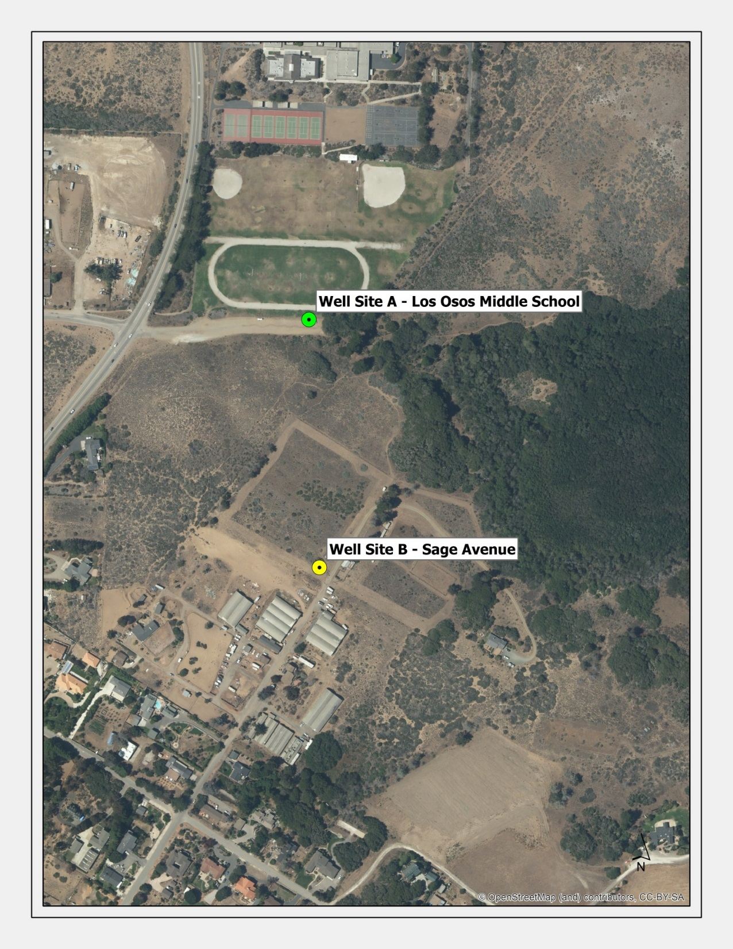
Site A – Adjacent to LOMS Play Fields
Site B – Private Property on Sage Avenue

Slide 5
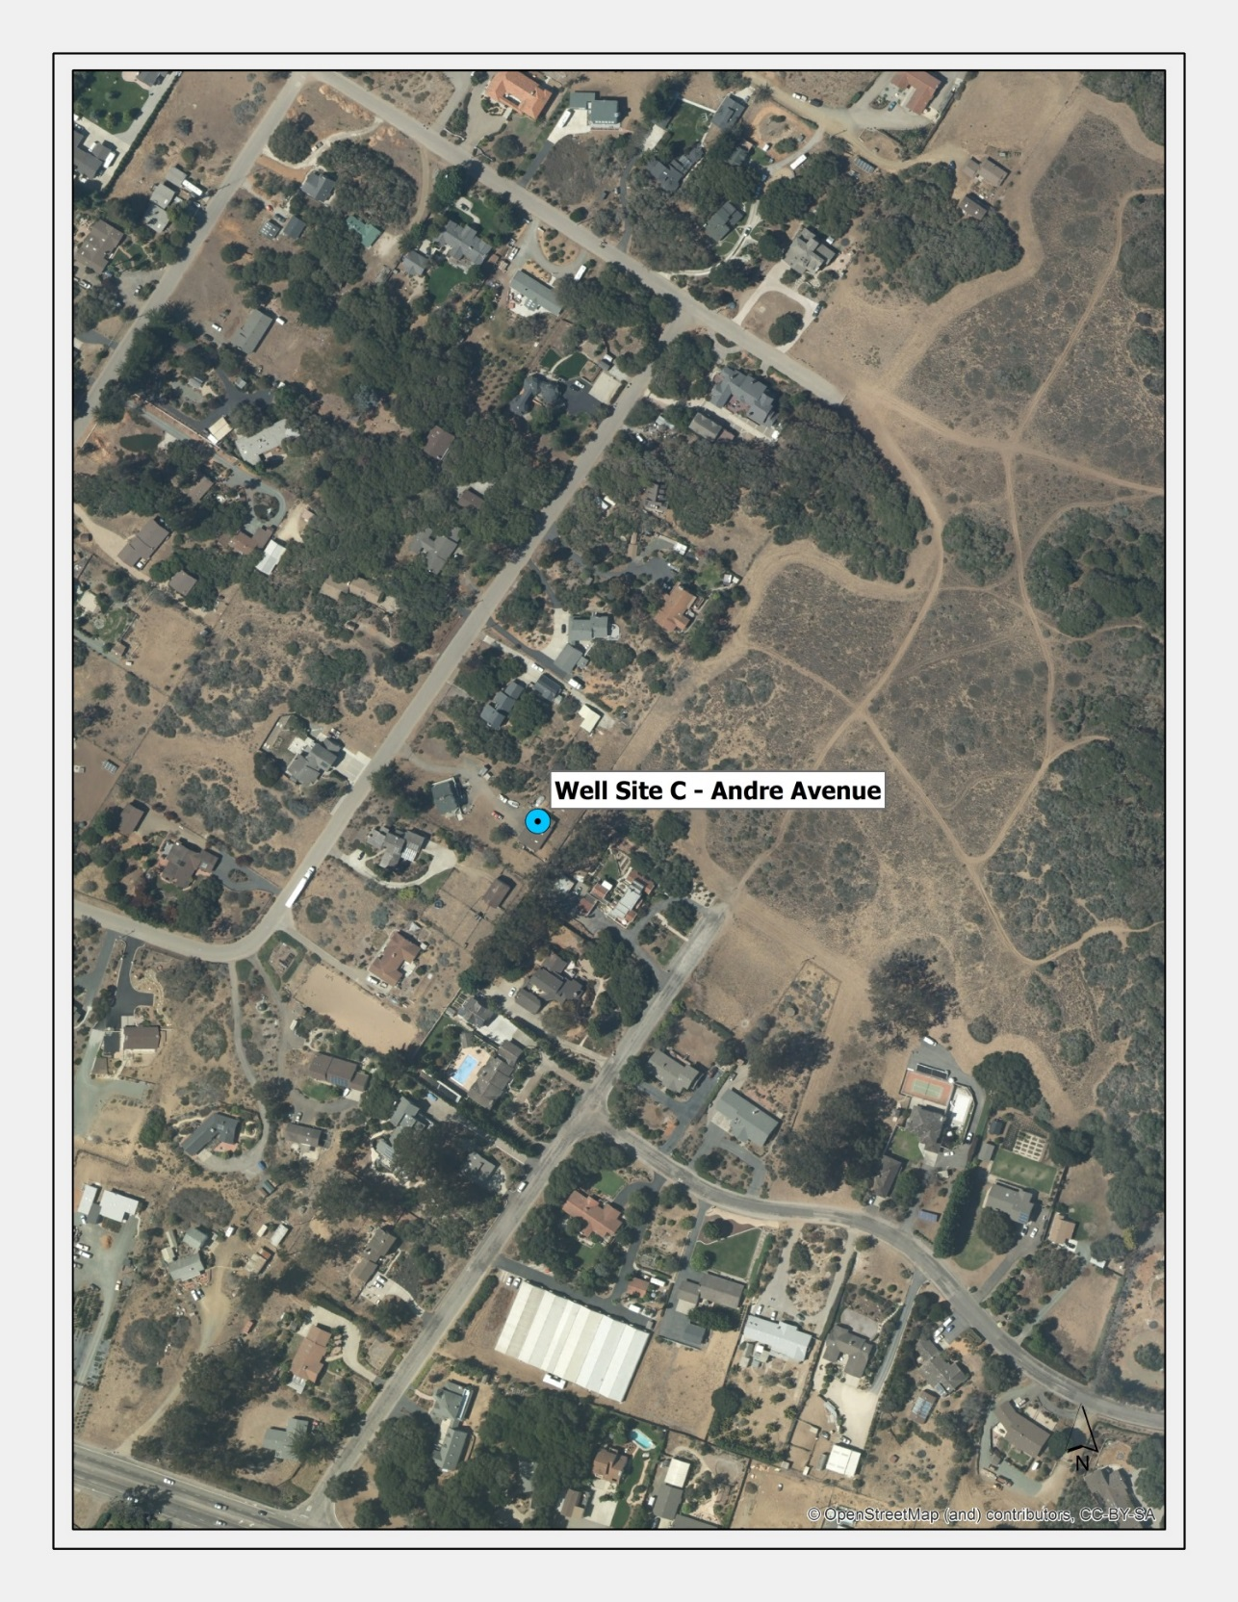
Andre Avenue
Site C – Private Property on Andre Avenue

Slide 6
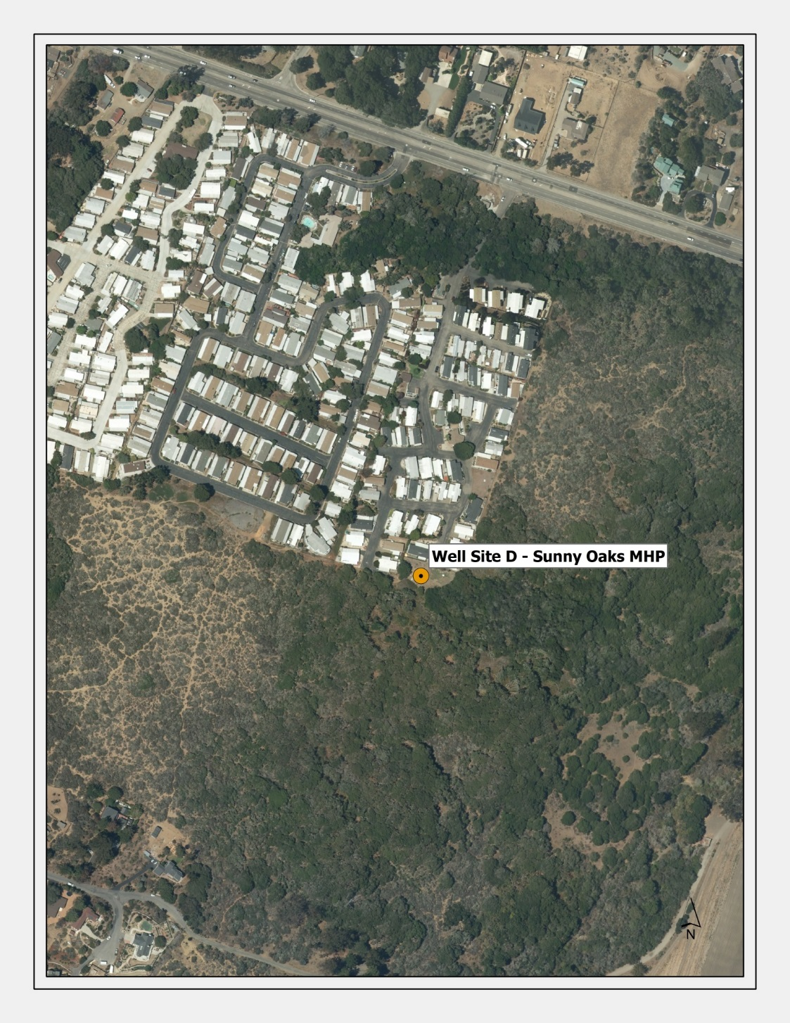
Los Osos Valley Road
Site D – Vacant Area South of Sunny Oaks MHP

Slide 7
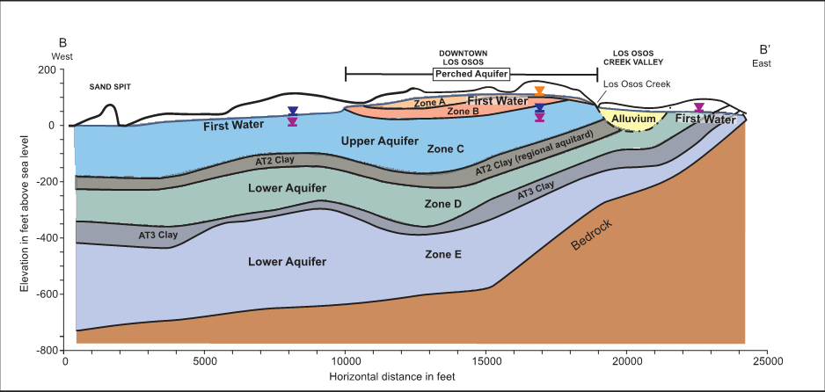
Basin Cross Section
Notes:
Ray Dienzo
LOCSD =634 AF
GSWC = 564 AF
ST= 48 AF

Slide 8
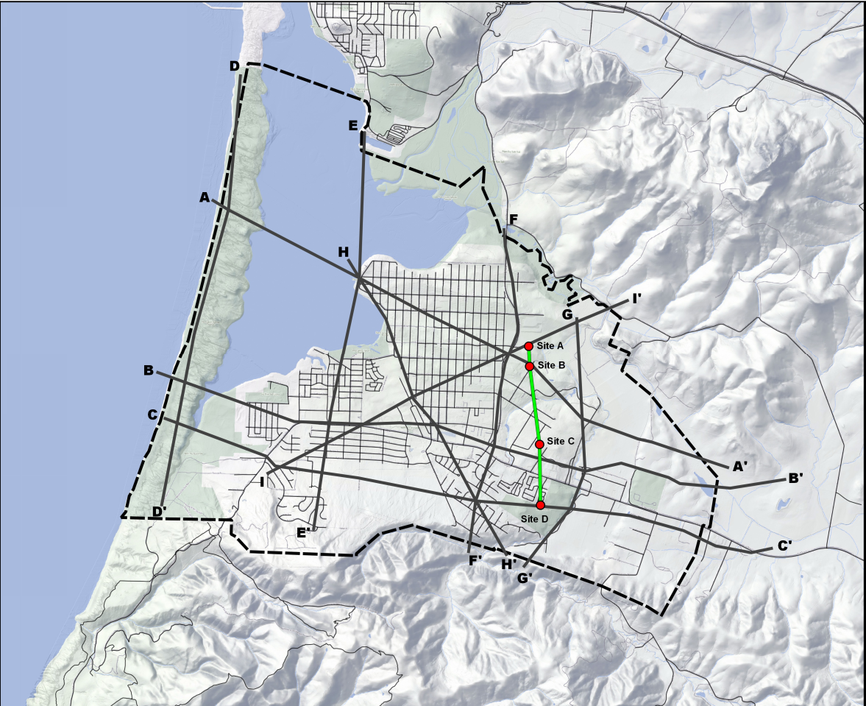
Notes:
Ray Dienzo
LOCSD =634 AF
GSWC = 564 AF
ST= 48 AF

Slide 9
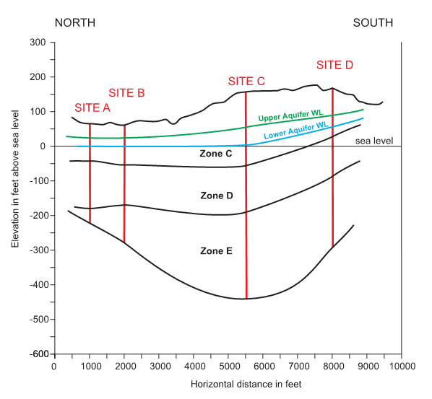
Basin Cross Section – Looking East
Notes:
Ray Dienzo
LOCSD =634 AF
GSWC = 564 AF
ST= 48 AF

Slide 10
Annual Production
Site A – LOMS (Zone D/E): Key concern, disadvantage – perhaps < 100 AFY
Site B – Sage (Zone D/E): Concern, disadvantage – perhaps < 100 AFY
Site C – Andre (Zone D/E): Deepest portion of Zones D & E, advantage, >140 AFY
Site D – Sunny Oaks (Zone C/D/E) – good production including Zone C, advantage
>190 AFY

Slide 11
Proximity to Infrastructure
(Community Water Mains)
Site A – LOMS: 1,100’ pipeline required, neutral
Site B – Sage: 2,200’ pipeline required, disadvantage
Site C – Andre: 600’ pipeline required, advantage
Site D – Sunny Oaks: 1,200 ‘ pipeline required using trenchless technology, neutral

Slide 12
Neighborhood/Community
Acceptance
Site A – LOMS: Expected to be non-controversial - advantage
Site B – Sage: Potential controversy, disadvantage
Site C – Andre: Significant community concern - disadvantage
Site D – Sunny Oaks: Neighborhood opinion unknown at this time

Slide 13
Seller Status and Land Cost
Site A – LOMS: Advantage
Site B – Sage: Unknown, premature
Site C – Andre: Advantage
Site D – Sunny Oaks: Unknown, premature

Slide 14
Aesthetic Concerns
Noise, Visual, other
Site A – LOMS: Advantage – not in residential neighborhood
Site B – Sage: On large residential parcel - mitigation required including submersible pump and sound proof enclosure
Site C – Andre: 1-acre lot in residential neighborhood – mitigation required including submersible pump and sound proof enclosure
Site D – Sunny Oaks: adjacent to mobile homes - mitigation required including submersible pump and sound proof enclosure

Slide 15
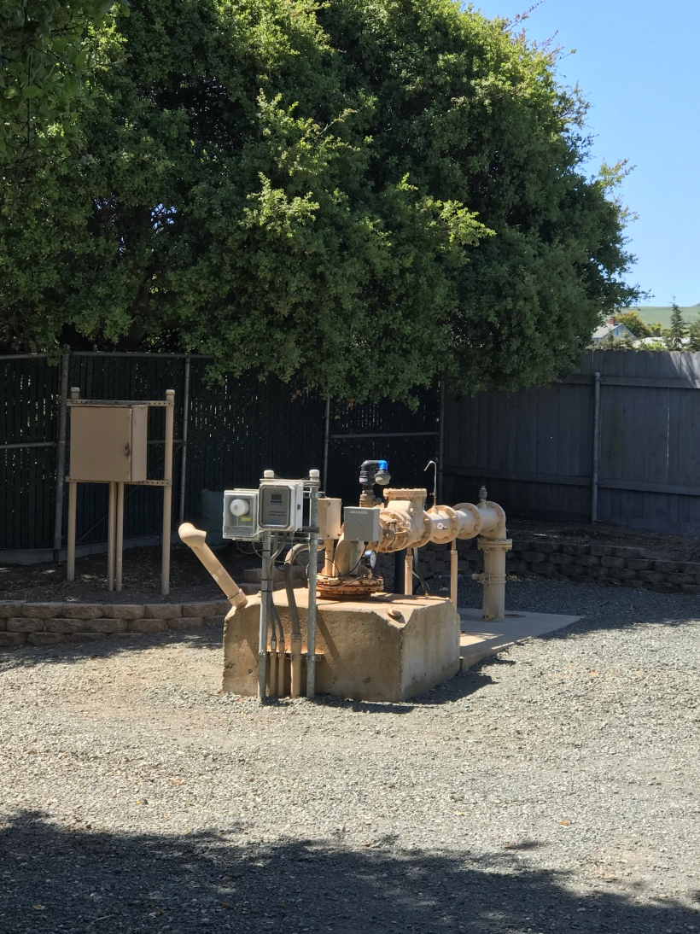
Example well site
No above ground motor – submersible proposed for all sites
Well piping and controls will be enclosed in building

Slide 16
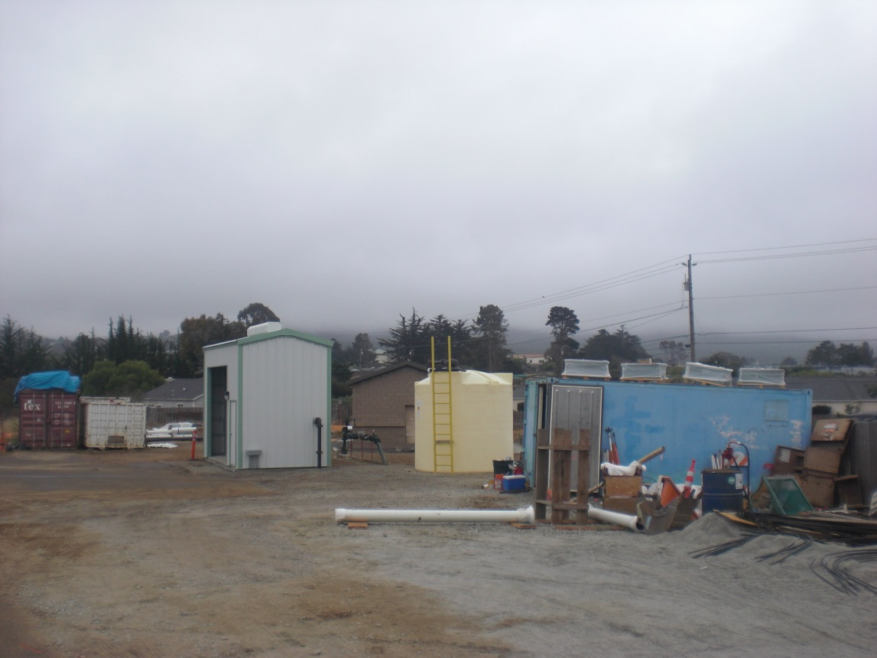
Use of site as corporation yard not anticipated – Example from LOCSD South Bay Well

Slide 17
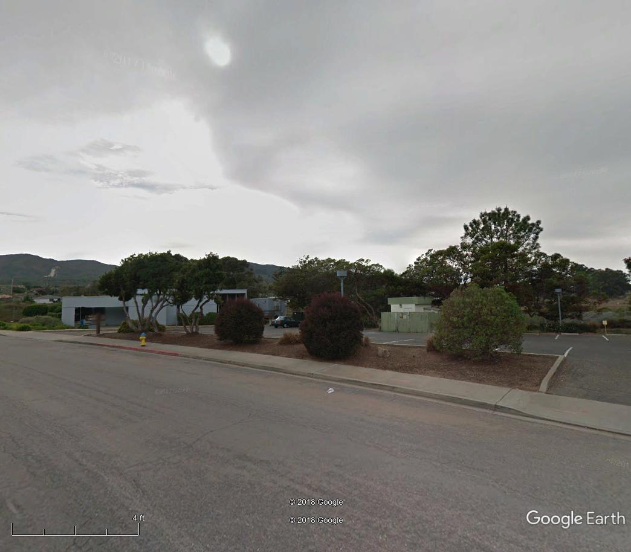
Example well sites – Palisades Well
Library building
Well in enclosure/building

Slide 18
Potential interference with
Surrounding wells
Site A – LOMS: Advantage – no residential wells in vicinity
Site B – Sage: Minor or negligible impacts to existing residential wells expected, mitigation may be required in environmental document
Site C – Andre: Minor or negligible impacts to existing residential wells expected, mitigation may be required in environmental document
Site D – Sunny Oaks: Advantage – no residential wells in vicinity

Slide 19
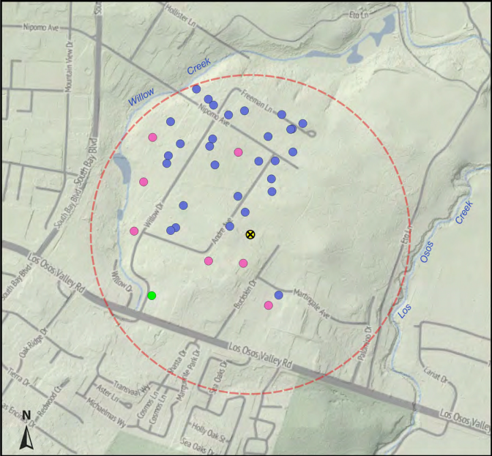
Potential Site C Well
Existing mixed aquifer well in pink
Existing upper aquifer well in blue
Existing perched aquifer well in green

Slide 20
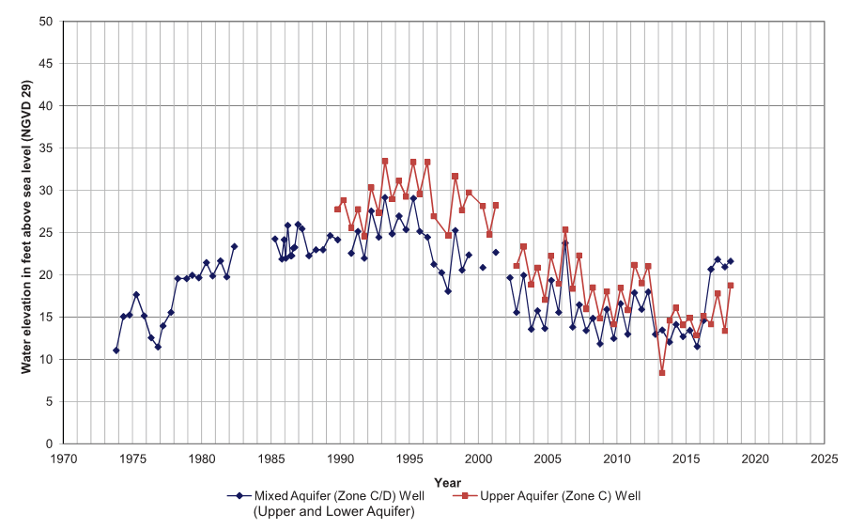

Slide 21
Potential interference with
Surrounding wells – Site C
Initial technical study to be released via web after review of draft
Impacts must be mitigated if site selected
Modeled impacts are range from 4’ to 6’ at full 200 acre ft per year production
Even with these small draw down levels, some impacts may require mitigation in wells adjacent to Site C
If pursued, additional field testing and discussion of specific mitigations will be recommended

Slide 22
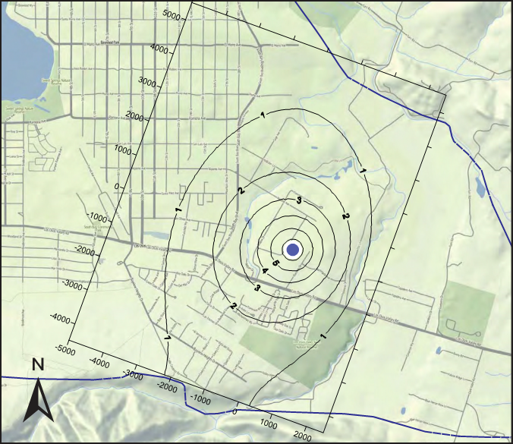
Modeled interference in upper aquifer wells

Slide 23
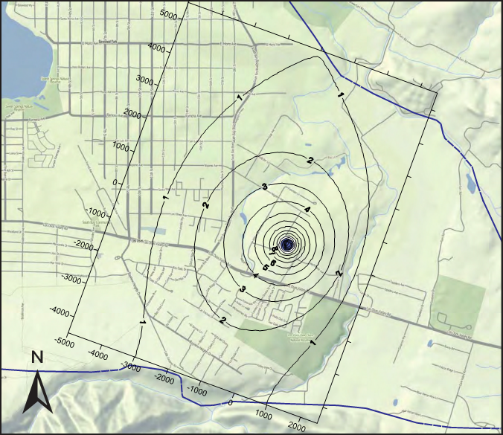
Modeled interference in mixed aquifer wells

Slide 24
Environmental and Endangered
Species Impacts
Site A – LOMS: Advantage – developed area
Site B – Sage: Disadvantage – undeveloped with potential habitat
Site C – Andre: Advantage - developed
Site D – Sunny Oaks: Disadvantage – undeveloped with potential habitat

Slide 25
Site Layout and Access
Site A – LOMS: Advantage with some constraints
Site B – Sage: Advantage
Site C – Andre: Disadvantage, but feasible
Site D – Sunny Oaks: Advantage

Slide 26
Environmental and
Coastal Development Permit Timing
Site A – LOMS: Advantage – developed, non-controversial site
Site B – Sage: Disadvantage – undeveloped habitat with potential neighborhood concerns
Site C – Andre: Disadvantage – neighborhood concerns
Site D – Sunny Oaks: Disadvantage – undeveloped habitat with potential neighborhood concerns

