Slide 1

Emergency Services Advisory
Committee Meeting
May 20, 2021 at 5:30
TO PARTICIPATE: On your computer
via Microphone or type your public comment into the Q & A Tab.
On your phone
call (929) 205-6099 or (301) 715-8592
Meeting ID: 854 9667 0841 and
Press *9 to raise your hand via phone.
Please note if you are on your computer but do not have a microphone, you will have to call in to speak, or write your public comment in the Q&A Tab.

Slide 2

Agenda Item 2:
Approve ESAC Meeting
Minutes of
February 18, 2021

Slide 3
Agenda Item 3:
Fire Department/Cal Fire
Update

Slide 4
Agenda Item 4:
Final Budget Review of Fiscal Year 2021/2022 Budget
for Fund 301

Slide 5
Fund 301 – Fire
Major Requests: Increase in Services and Supplies, increase in unfunded accrued liabilities for retirements.
Impact to Budget: The increase in the Services and Supplies budget is $46,157, increase in unfunded accrued liabilities for retirement costs is about $10,400.

Slide 6
Fund 301 – Fire
Zone A Property Tax Allocation – 5% increase in allocation over FY 2020-21
Note: Schedule A (labor) costs remain the same as FY 2020-21 at $2,465,234
Estimated Zone B revenues increase by about 2% or approx. $48,400
Special Fire Tax will increase by 1.74% or approx. $10,400

Slide 7
Fund 301 – Fire
Fund 301 Budget Category | 2020-2021 Budget | 2021-2022 Budget | Increase/ (Decrease)
Revenue | $3,125,817.05 | $3,199,639.60 | $73,822.55
Expenditures
Total Personnel | $267,317.00 | $273,514.00 | $6,197.00
Services & Supplies | $2,575,351.97 | $2,621,509.66 | $46,157.69
Capital Outlay | $805,609.00 | $80,363.04 | -$725,245.96
Reserves | $192,549.24 | $183,713.00 | -$8,836.24
Transfers | $66,496.84 | $66,111.05 | -$385.79
Total Expenditure | $3,907,324.05 | $3,225,210.75 | -$682,113.30
Total Revenue | $3,125,817.05 | $3,199,639.60 | $73,822.55

Slide 8
Fund 301 – Fire
Next fire truck replacement scheduled for FY 2034-35

Slide 9
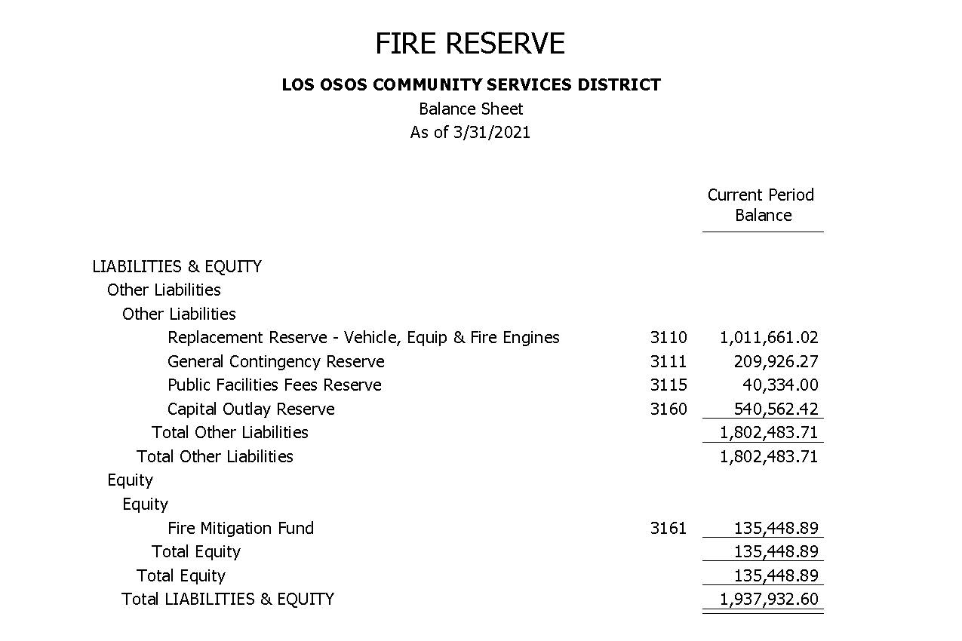
Fund 301 – Fire

Slide 10
Fund 301 Budget Review
Questions/Comments

Slide 11
Agenda Item 5:
Community Survey & Outreach Plan

Slide 12
Agenda Item 5 – Emergency Services Community Survey
Purpose:
Develop a community survey to better understand the community’s expectations for Station 15 regarding both current and future levels of service.

Slide 13
Agenda Item 5 – Emergency Services Community Survey
Objectives:
Questions we need to answer:
  What do we want to learn?
  How is this survey data going to help us?

Slide 14
Agenda Item 5 – Emergency Services Community Survey
Survey Question Types:
Open questions: What are you planning on buying at the market today?
Closed questions: Answer yes or no; Are you feeling better today?
Mixed matrix questions: Use a rating scale from 1 to 5; How would rate our service with 5 being the highest?
Single or Multi response questions: Questions where a user is asked to pick one or more answers from a pre-determined set of responses; What kind of music do you like? Jazz, Rock, Metal, Pop?

Slide 15
Agenda Item 5 – Emergency Services Community Survey
Rules of Thumb:
  Avoid leading questions.
  Avoid asking questions that confine the responses to very narrow possibilities, e.g.: “What are the two or three services that you care about most?” And avoid asking participants to respond to a short list of issues or services that you think are important. By doing so, you will be suggesting answers to the participant instead of giving them the opportunity to tell you how they see things.
  Allow for open-ended responses (Why did you rate….?) so that you do not come to erroneous assumptions, and hence develop the wrong solutions for resolving poor ratings or curtail practices that resulted in good ratings.
In formulating the questions, we must keep in mind how to tabulate the results in a way that will provide a representation of the community’s view of our emergency services and create a vision moving forward.

Slide 16
Agenda Item 5 – Emergency Services Community Survey
Survey Question Examples:
Germantown Fire Department: combination question types
Beverly Hills Fire/Emergency Response Survey: single response questions

Slide 17
Agenda Item 5 – Emergency Services Community Survey
Survey Distribution & Outreach Plan:
Distribution methods can be one or more of the following methods:
Direct mail- randomly select addresses from different areas of Los Osos and provide a postage paid return option.
Social Media- use the District’s Facebook page as an option to advertise, view and fill out the survey.
District Website- provide the survey on the District’s website and promote through local media and community-based organizations.

Slide 18
Agenda Item 5 – Emergency Services Community Survey
Next Steps:
  Staff will develop a draft survey and circulate by email for committee input and feedback.
  Finalize survey and distribution plan at the August ESAC meeting.

Slide 19
Agenda Item 5 – Emergency Services Community Survey
Questions/Comments

Slide 20

Agenda Item 6:
Public Comment For Items
Not On The Agenda
To Speak:
Raise your Hand by clicking on your computer
Or Press *9 to raise your hand via phone.

Slide 21
Agenda Item 6:
Schedule Next ESAC Meeting
August 19, 2021
at 5:30pm

Slide 22
Agenda Item 7:
Closing Comments by
ESAC Committee Members

Slide 23
Agenda Item 8:
Adjournment

